Slide 1
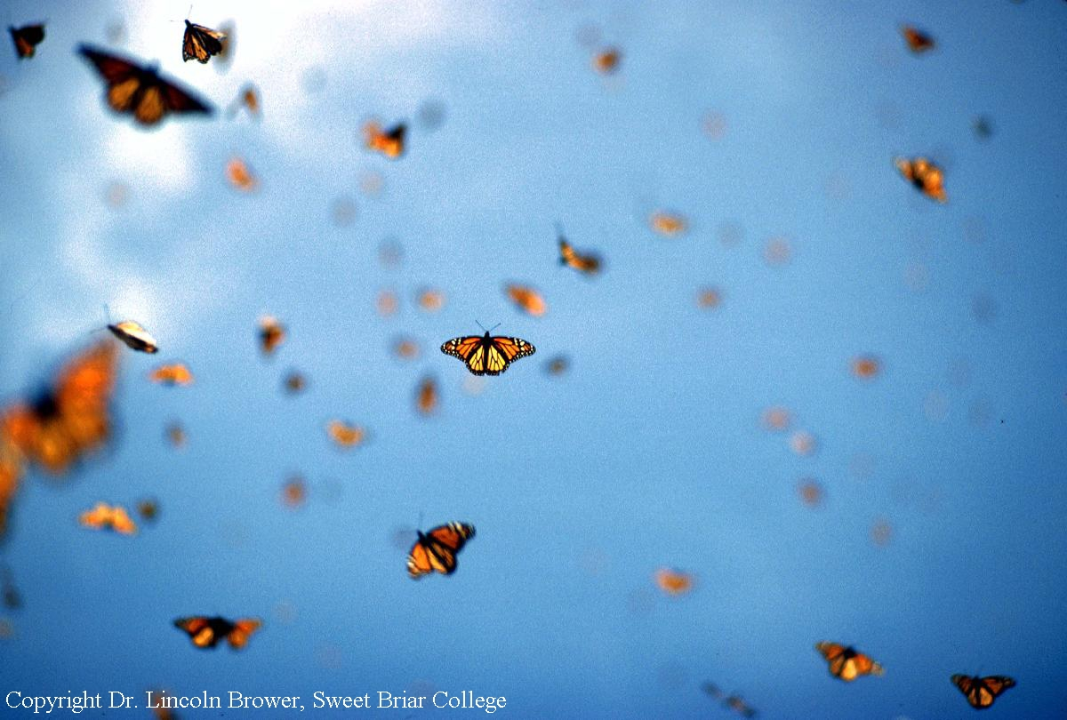
Using math to save monarch butterflies!
Girls Math & Science Day 2020

Slide 2

The monarch’s annual cycle
Spring Migration & Breeding
Summer Breeding

Slide 3
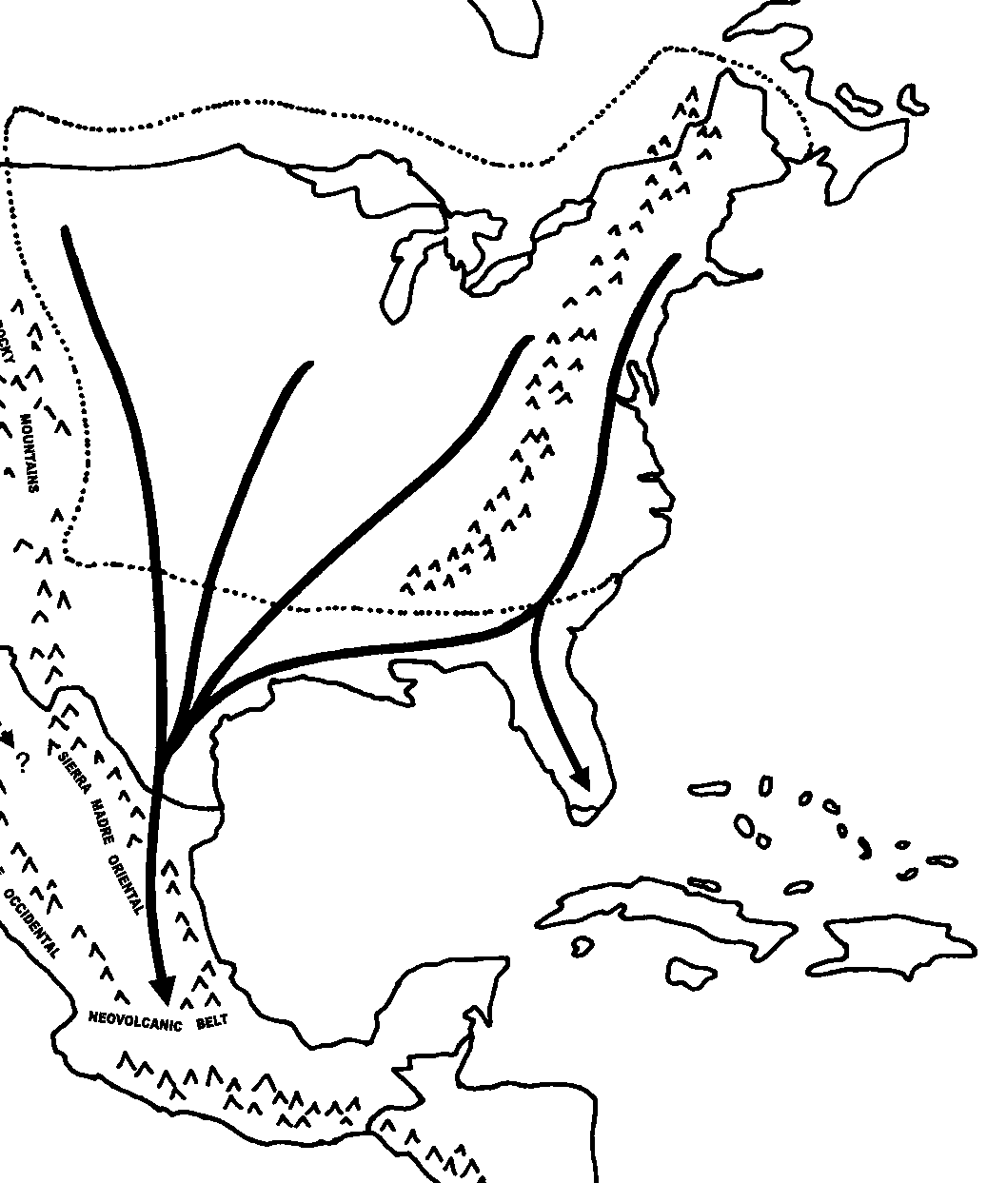
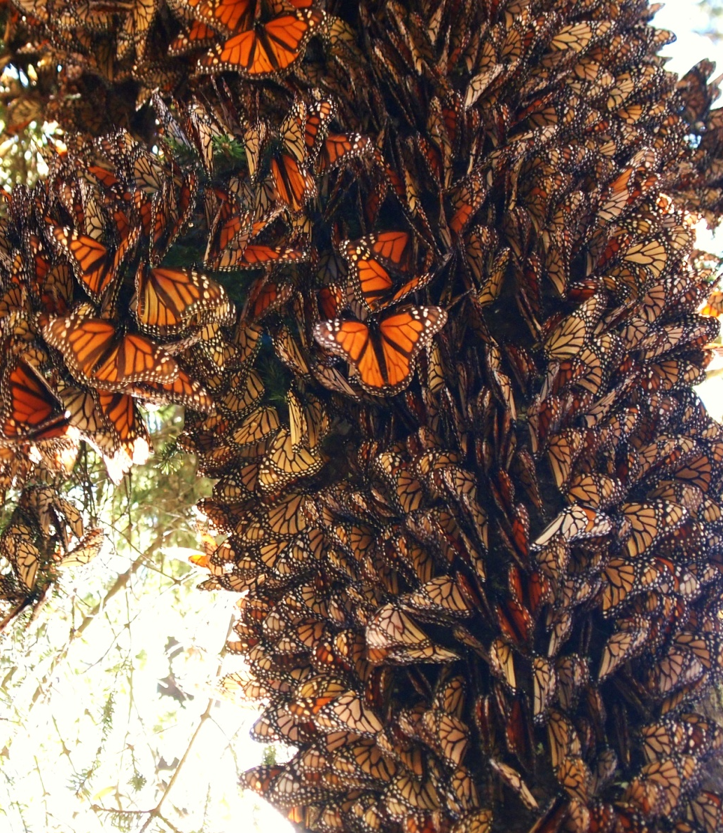
The monarch’s annual cycle
Fall Migration
Notes:
2,500+ mile journey; reproductive diapause

Slide 4

Monarch population decline
2017
2018

Slide 5

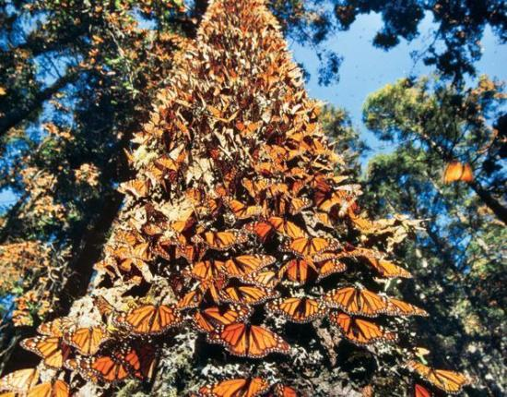
Why are monarchs declining?
Logging of winter habitat

Slide 6
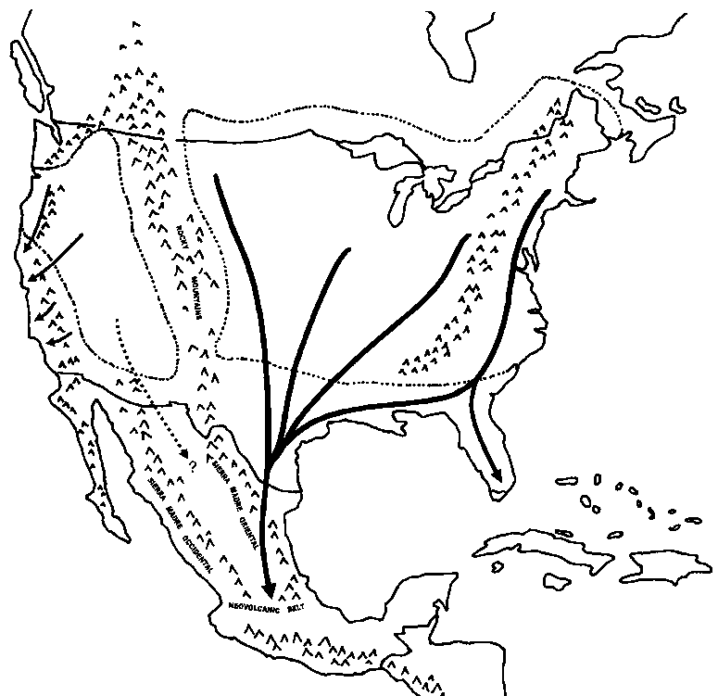
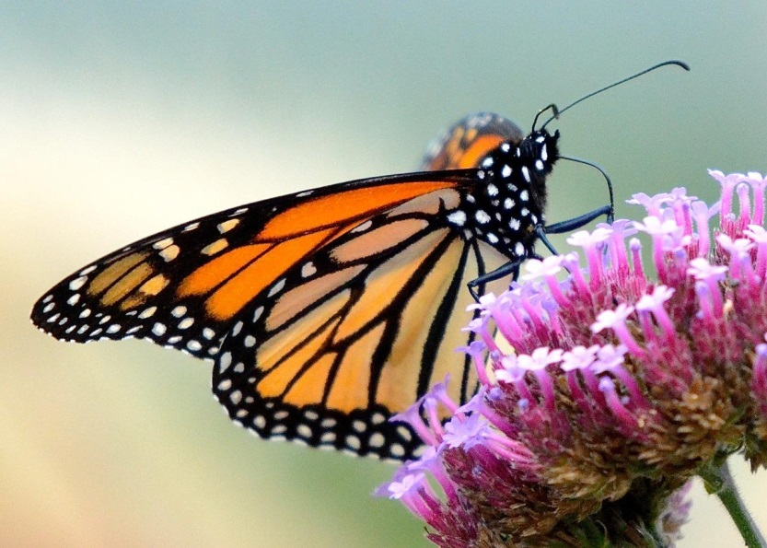
Why are monarchs declining?
Loss of nectar plants
FALL

Slide 7
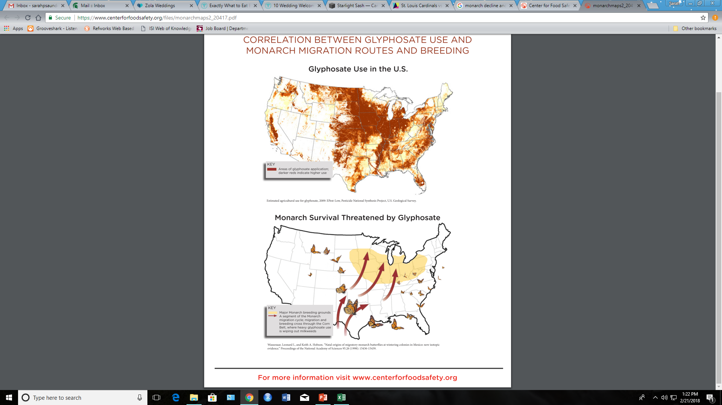
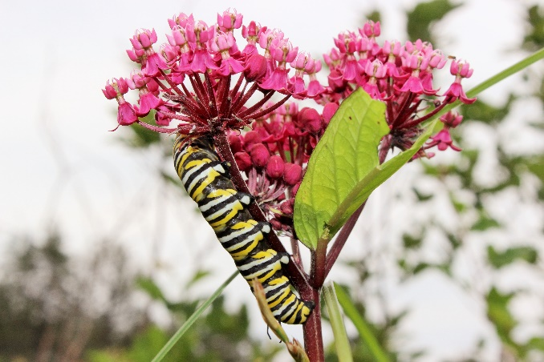
Why are monarchs declining?
Milkweed loss

Slide 8
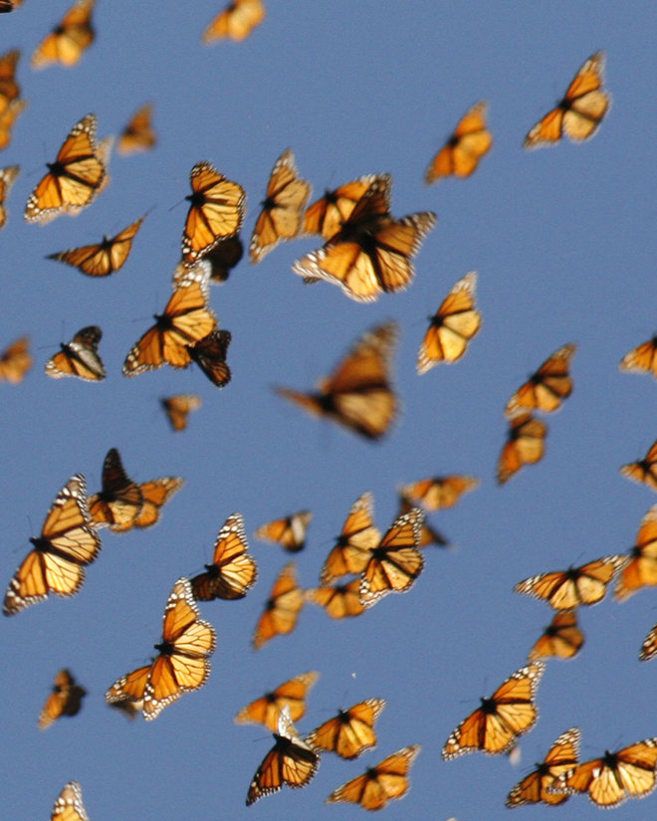
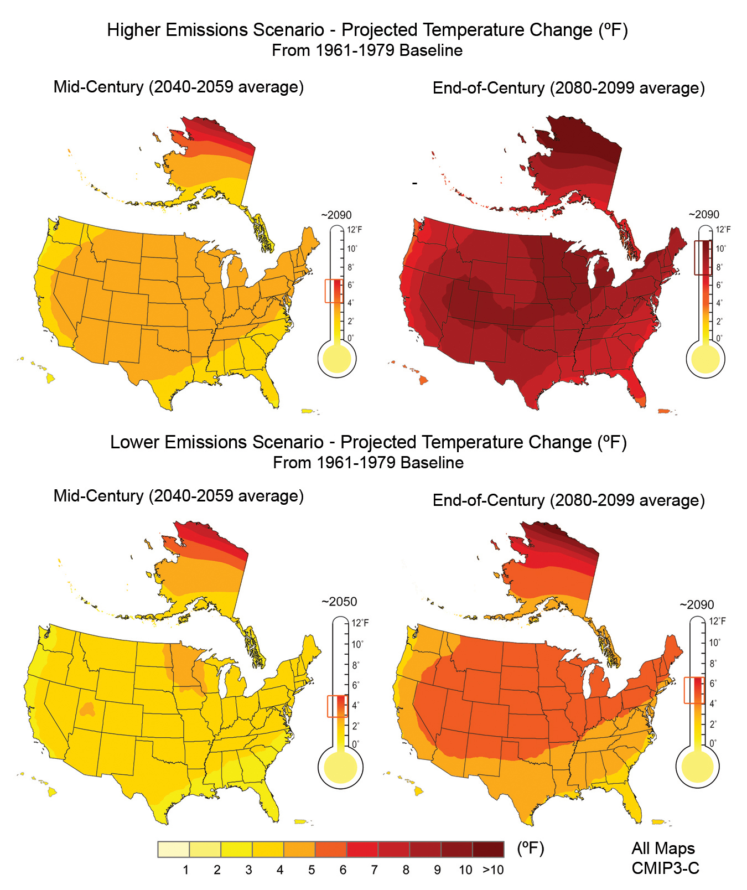
Why are monarchs declining?
Climate change

Slide 9
How can we use math to save monarchs?
Let’s use a model!

Slide 10
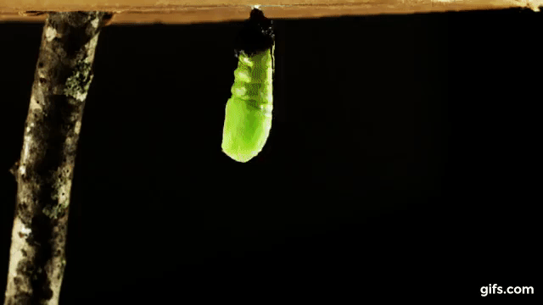
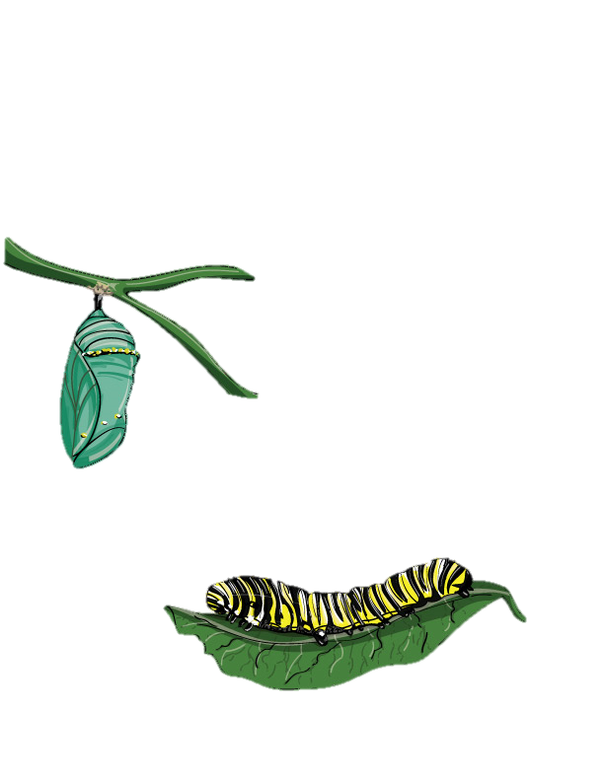
What are models?
Notes:
Models are what we use to describe or represent a process. For example, models can be visual like this visual model of monarch metamorphosis.

Slide 11
Mathematical models
Using math to describe reality

Slide 12
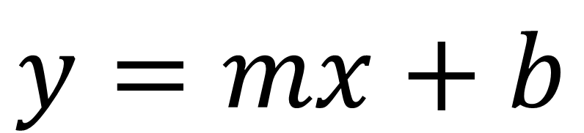
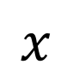
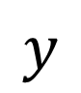
Mathematical models
$$y$$
$$x$$
$$y=mx+b$$
Notes:
And models can be mathematical or statistical. Many of you probably recognize this equation as the model for a line or relationship between x and y.

Slide 13
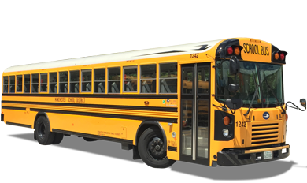
Uncertainty & statistics
Notes:
When we use models to make estimates, we expect to see some variation or uncertainty around that estimate. For example, your school bus arrives around the same time every morning, say 8:00am, but some mornings the bus may be a little bit early and some mornings it may be a little bit late, but you expect your bus to arrive around 8am every day.

Slide 14

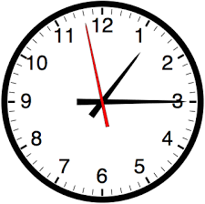
Models in ecology
How many individuals are there?
Where are these individuals located?
How is this population changing over time?
Notes:
In ecology, we use models to estimate the number of individuals in a population, where these individuals might be located, and we can estimate how the population size changes over time.

Slide 15
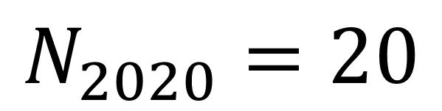
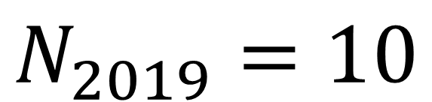
Population change
Population
Last Year
$$N_{2019}=10$$
INCREASING!
Population
This Year
$$N_{2020}=20$$
Notes:
To estimate population change over time, we can look at the differences in population size from year to year. So between last year and this year, we can see that our population is increasing

Slide 16
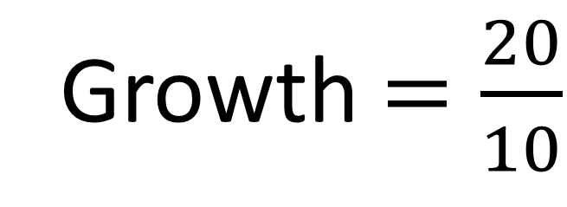
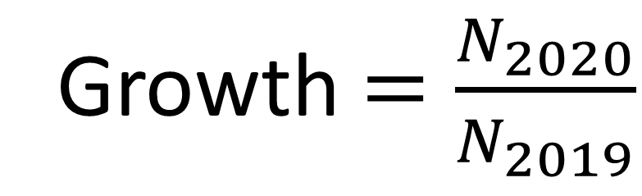
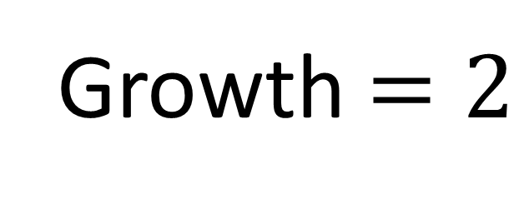
Population change
Growth $=\frac{N_{2020}}{N_{2019}}$
Growth $=\frac{20}{10}$
Growth $=2$
Notes:
To calculate the rate of population change between years, we can divide the population this year by the population last year. If this rate is greater than 1, the population is increasing.

Slide 17
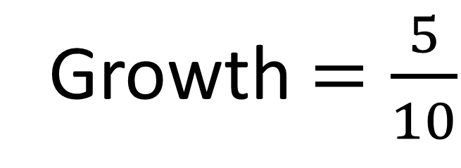
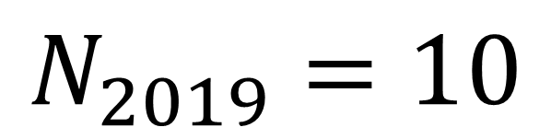
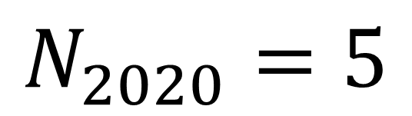
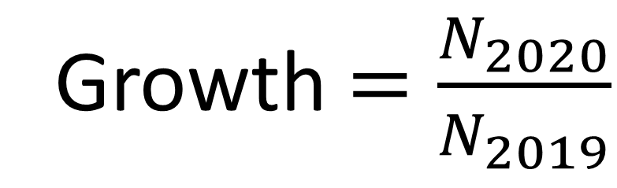
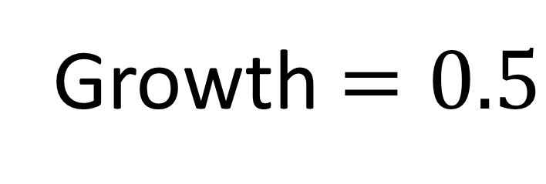
Population change
$$N_{2019}=10$$
Growth $=\frac{N_{2020}}{N_{2019}}$
$$N_{2020}=5$$
DECREASING!
Growth $=\frac{5}{10}$
Growth $=0.5$
Notes:
We are doing the same population growth rate calculation here, and we can see that now, our population size this year divided by our population last year is less than one, so we say our population is decreasing.

Slide 18
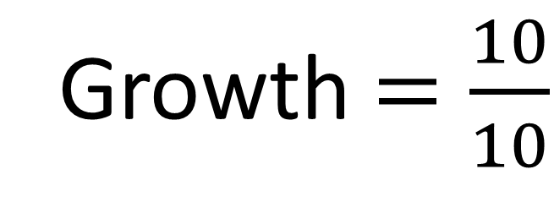
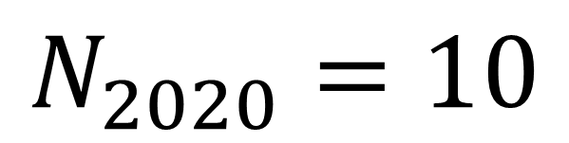
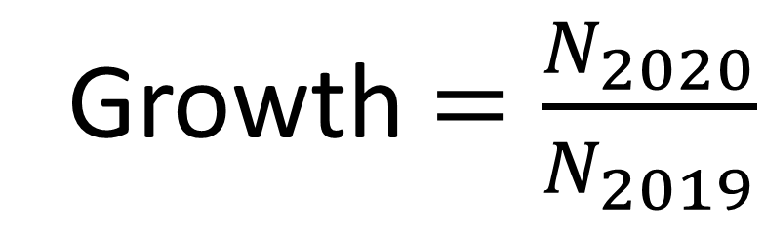
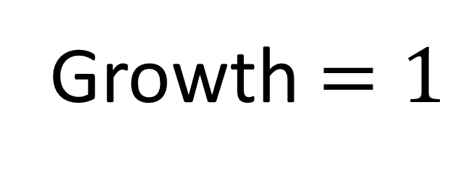
Population change
$$N_{2019}=10$$
Growth $=\frac{N_{2020}}{N_{2019}}$
$$N_{2020}=10$$
CONSTANT
Growth $=\frac{10}{10}$
Growth $=1$
Notes:
If our population doesn’t change between last year and this year, the growth rate is 1, and this means our population is constant

Slide 19
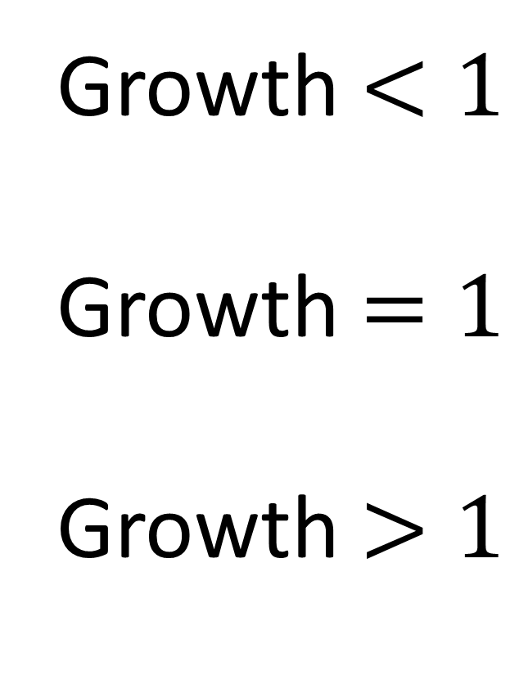
Population change
Growth $<1$
Growth $=1$
Growth $>1$
DECREASING
CONSTANT
INCREASING
Notes:
To review, if our population growth rate is less than 1, our population is decreasing; if the growth rate equals one, the population is constant; and if the growth rate is greater than one, our population is increasing over time.

Slide 20
Monarch module
Nectar plants
Winter forest habitat
Milkweed habitat
Climate change
Module Link:
https://danaus.shinyapps.io/Danaus/

Slide 21
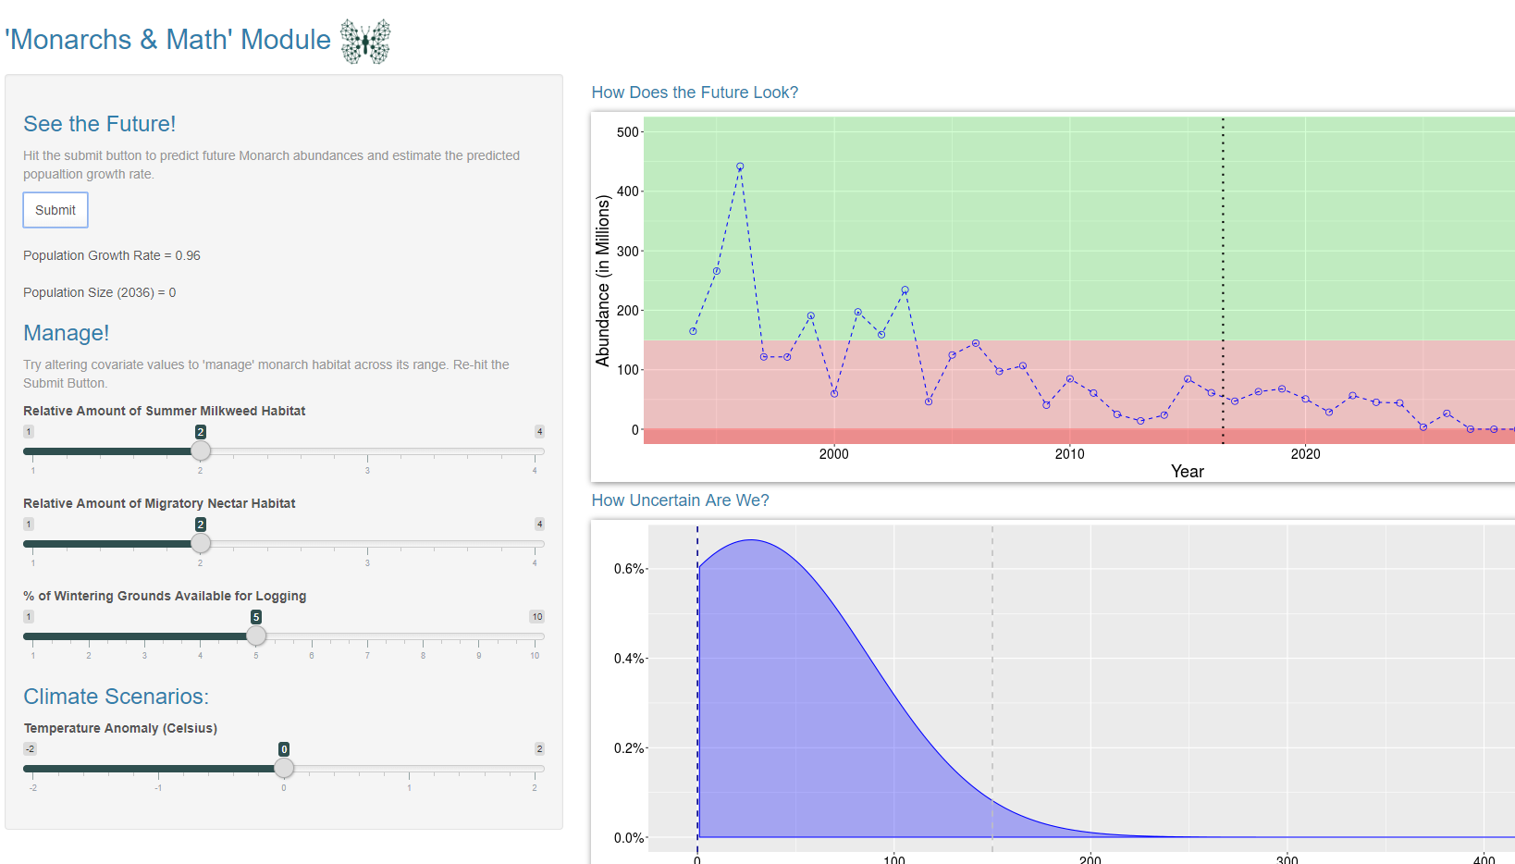
Monarch module
Inputs
Run Module
Outputs
Fill out the exercise sheet by interacting with the web app
Answer Q’s on the back!

Slide 22
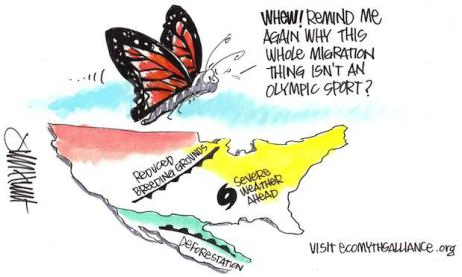

What can you do to help?
Make an area of your yard a monarch habitat!
Plant milkweed & nectar plants
Spread the word!

